Slide 1
Week 4 – Lab B Switch Statements & Enumerated Types (Enums)

Slide 2


Outline
Switch statements
Enumerated types (enums)

Slide 3
Recap: Selection Statements
We’ve seen different types of selection statements so far in this unit
If, If-else, If-else ladders
if (score >= 70)
System.out.println("First");
else if (score >= 60)
System.out.println("2:1");
else if (score >= 50)
System.out.println("2:2");
else if (score >= 40)
System.out.println("3rd");
else
System.out.println("Fail");
if (score >= 40)
System.out.println("Pass");
else
System.out.println("Fail");
Switch Statements
Enumerated Types (Enums)

Slide 4
Switch Statement
Java includes another commonly-used selection statement called the switch statement
A Switch statement allows the executing program to follow one of several paths based on a single value or expression
Sometimes considered more readable than an if-else ladder
Switch Statements
Enumerated Types (Enums)

Slide 5
Switch Statement Syntax
Variable / Expression must be one of the following types:
char, byte, short, int, String, or an Enum
switch ( variable / expression )
{
case value1 :
statement-list1
case value2 :
statement-list2
case value3 :
statement-list3
case ...
} //end switch
Switch Statements
Enumerated Types (Enums)

Slide 6
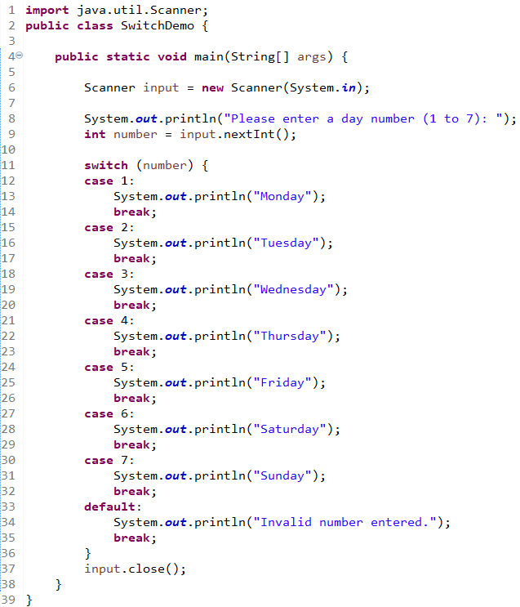
Switch Example
Application:
Ask the user for a number from 1 to 7 to represent the day of the week (1 = Mon , 2 = Tues, .. 7 = Sun)
Store the input in a variable
Check the value of that variable, printing out the text equivalent
If a number is invalid, print out a message indicating the input was invalid
Example:
User inputs 3
Program prints “Wednesday”
Switch Statements
Enumerated Types (Enums)

Slide 7
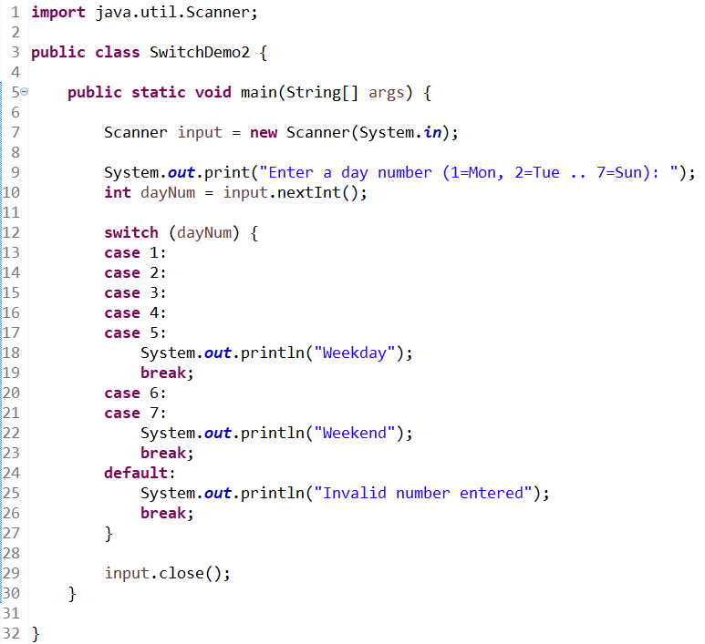
Fall through
We’ve seen that the break keyword causes the switch statement to terminate and carry on executing the rest of the program
Without break statements, each time a match occurs in the switch, the statements for that case and subsequent cases execute until a break statement (or the end of the switch) is encountered
This is often referred to as “falling through” to the statements in subsequent cases
Switch Statements
Enumerated Types (Enums)

Slide 8
ENUMERATED TYPES (ENUMS)
Switch Statements
Enumerated Types (Enums)

Slide 9

Recap: Constants
Constants are values which do not change (i.e. they are constant)
We use the final keyword in Java to denote a value does not change after it has been assigned
By convention, names of constants are ALL_CAPS
final int PASS_MARK = 40;
PASS_MARK = 41; // error - will not compile
Switch Statements
Enumerated Types (Enums)

Slide 10
Constants
We may be tempted to use integer constants in the following way to represent a group of similar types
Using constants in this way is error-prone and a nuisance – code will often compile and lead to logic errors
final int SPRING = 0;
final int SUMMER = 1;
final int AUTUMN = 2;
final int WINTER = 3;
int season = AUTUMN; // current season is autumn
season = season + 6; // code will compile (2 + 6), but does that make sense?
Switch Statements
Enumerated Types (Enums)

Slide 11
Enumerated Type (Enum)
If we need to define a list of permitted values for a type, we can use an enumerated type, often called an enum
We use the enum keyword and list all of the permittable values for our program within its body { }
enum Season { SPRING, SUMMER, AUTUMN, WINTER }
enum Apple { GRANNY_SMITH, GOLDEN_DELICIOUS, PIPPIN }
enum Planet { MERCURY, VENUS, EARTH, MARS, JUPITER, SATURN, URANUS, NEPTUNE }
enum TrafficLightColour { RED, AMBER, GREEN }
Switch Statements
Enumerated Types (Enums)

Slide 12
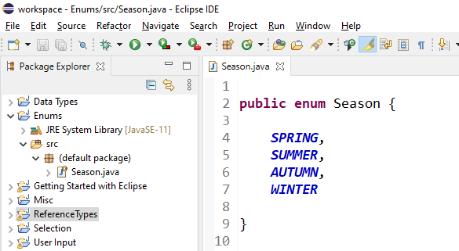
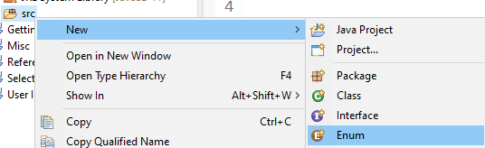
Declaring Enums
You can declare an enum in its own file
Switch Statements
Enumerated Types (Enums)

Slide 13
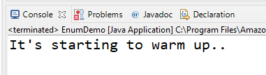
Declaring Enums
class EnumDemo {
enum Season { WINTER, SPRING, SUMMER, AUTUMN };
public static void main(String[] args) {
Season currentSeason = Season.SPRING;
if (currentSeason == Season.WINTER)
System.out.println("Brrr. It's cold!");
else if (currentSeason == Season.SPRING)
System.out.println("It's starting to warm up..");
else if (currentSeason == Season.SUMMER)
System.out.println("It's pretty hot!");
else
System.out.println("It's starting to cool down..");
}
}
You can also declare an enum within a class
Must be at the class-level – cannot place an enum declaration in a method
Switch Statements
Enumerated Types (Enums)

Slide 14
Enums & Switch Statements
enum Season { SPRING, SUMMER, AUTUMN, WINTER }
class SwitchEnumDemo {
public static void main(String[] args) {
Season currentSeason = Season.WINTER;
switch (currentSeason) {
case WINTER: // NOT Season.WINTER
System.out.println("December, January, February");
break;
case SPRING:
System.out.println("March, April, May");
break;
case SUMMER:
System.out.println("June, July, August");
break;
case AUTUMN:
System.out.println("September, October, November");
break;
}
}
}
Enums can also be used within Switch statements
In this scenario, you only provide the different Enum “states” to the switch statement
Switch Statements
Enumerated Types (Enums)

Slide 15

Summary
Switch Statements
The switch statement is another type of multiple-selection statement available to us in Java
We can combine cases together by omitting break statements
Break statements within a switch allow for control of the program to leave the switch statement and continue executing the rest of the program
Enumerated Types
We can use enums to restrict a type to a list of specific values
Enums often lead to more readable and maintainable code (especially compared to using integer constants)
Enums can be used in conjunction with Switch statements to further increase the readability of our programs
Switch Statements
Enumerated Types (Enums)

